Slide 1


The Food Mess Revolution:
From Kitchen to Table
Fresh Market Delivery Service

Slide 2
Group Members
Pratik Bari
Rajesh Thore
Harshal Patil

Slide 3

Problem Statement
To create a Mess Management System that Track Orders, Inventory, Payments, Users, and Meal Plans. The system will automate daily operations, ensuring timely meal delivery and accurate inventory control. It will provide real-time updates on stock and payment statuses.

Slide 4
Objective
The objective of this project is to develop an automated Mess Management System that streamlines the daily operations of order tracking, inventory management, payments, and meal plans. The system aims to improve efficiency by providing real-time updates on stock and payment statuses, ensuring timely meal delivery, and minimizing errors in inventory control.

Slide 5
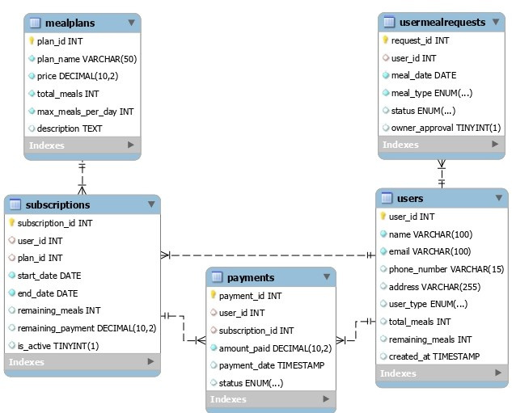
ER Diagram

Slide 6

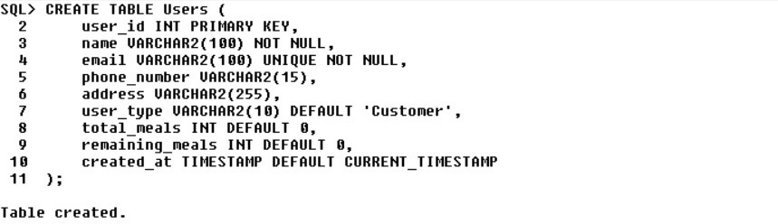
PARENT TABLE

Slide 7
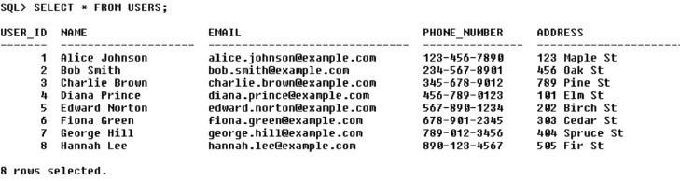
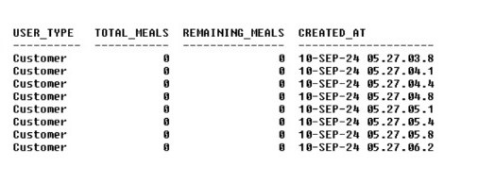

Slide 8

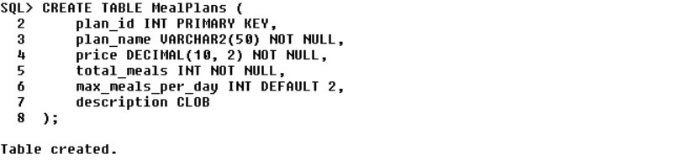
MEAL PLANS

Slide 9
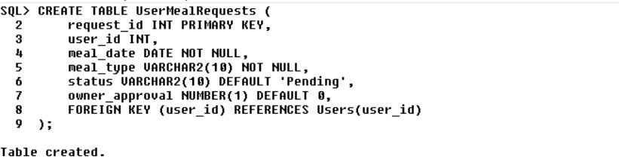
USER MEAL REQUESTS

Slide 10
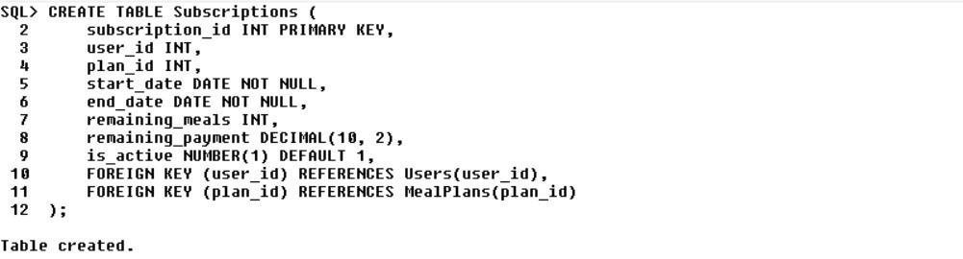
SUBSCRIPTIONS

Slide 11
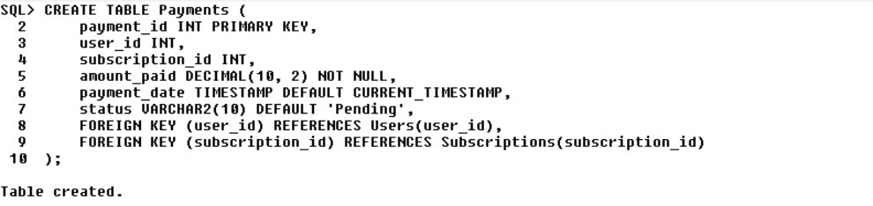
PAYMENTS

Slide 12
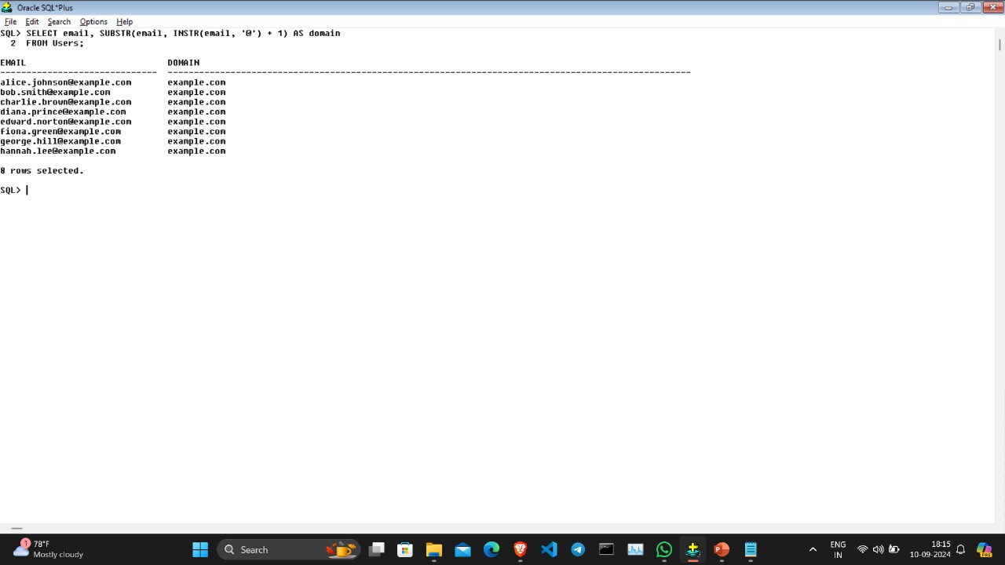
1. Write a SQL query to extract the domain part of the email addresses from the Users table
using a single row function. For example, if the email is alice.johnson@example.com, the domain part should be example.com

Slide 13
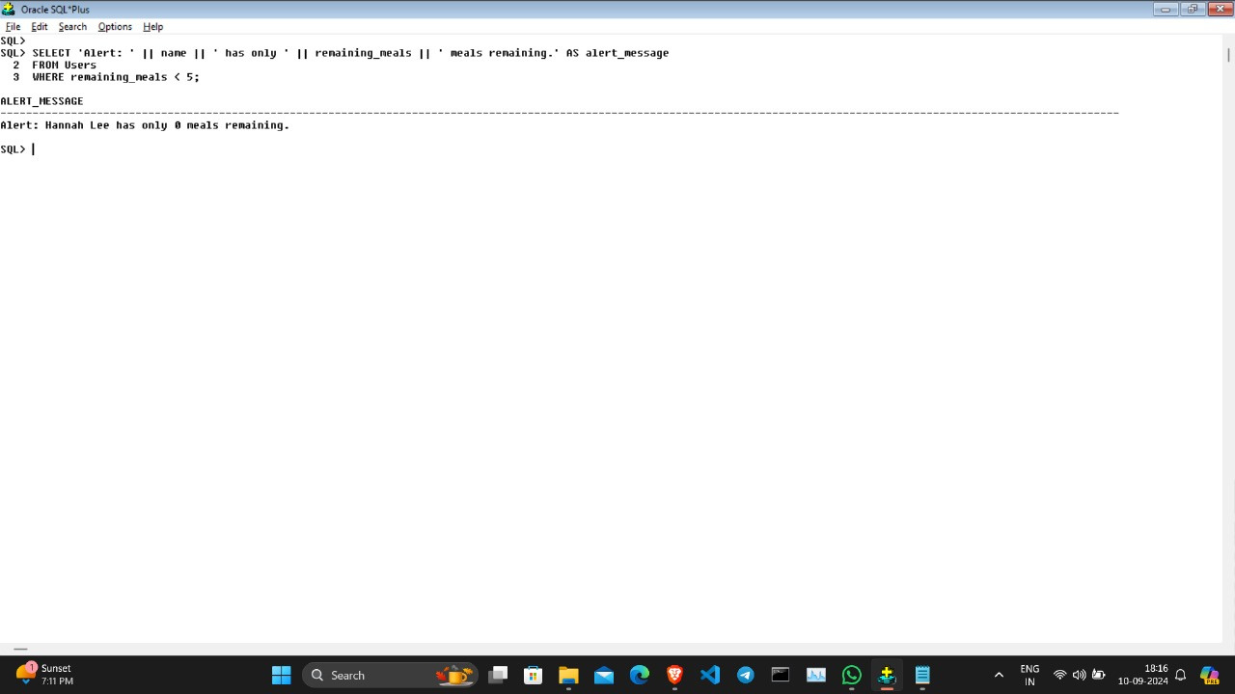
2. Write a SQL query to display an alert message for users who have less than 5 meals remaining in their meal plan. Use a subquery to get the remaining meals and generate the alert message. The alert message should be in the format: "Alert: [User Name] has only [remaining_meals] meals remaining.

Slide 14
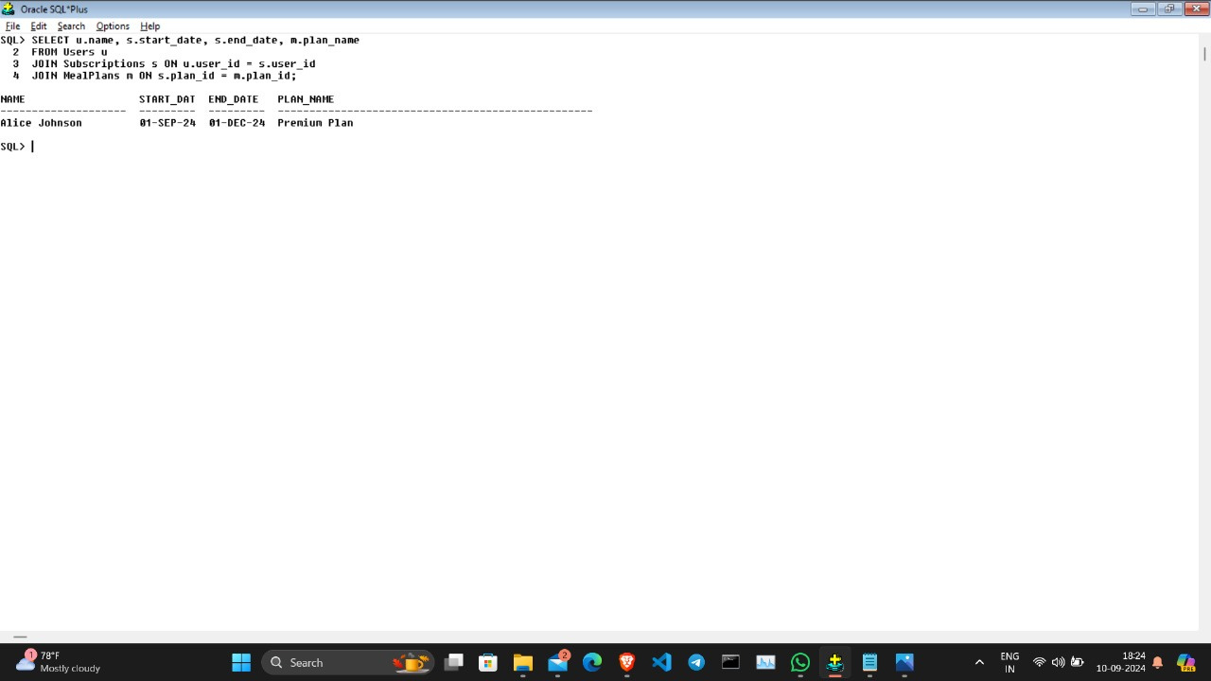
3. Query Users and Their Subscriptions

Slide 15
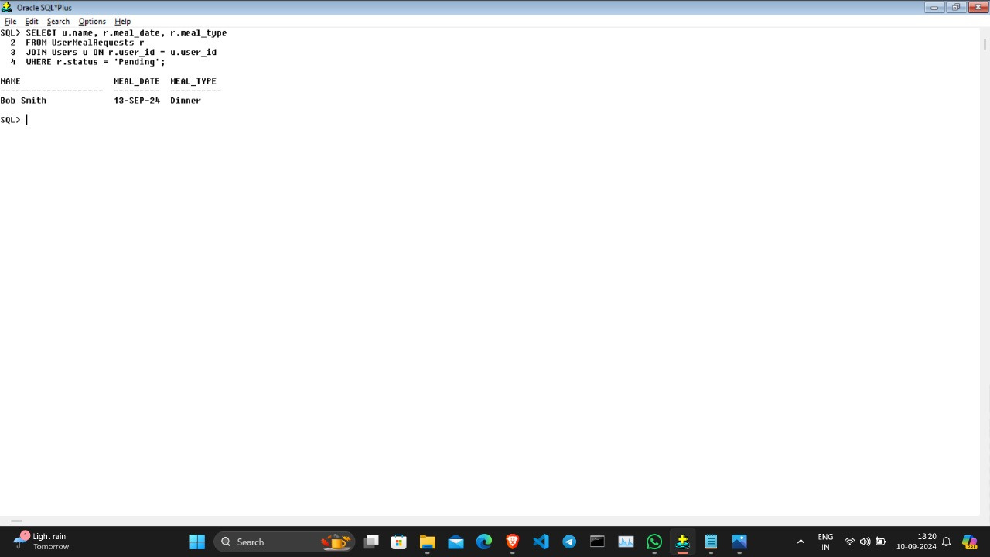
4. Find Pending Meal Requests

Slide 16
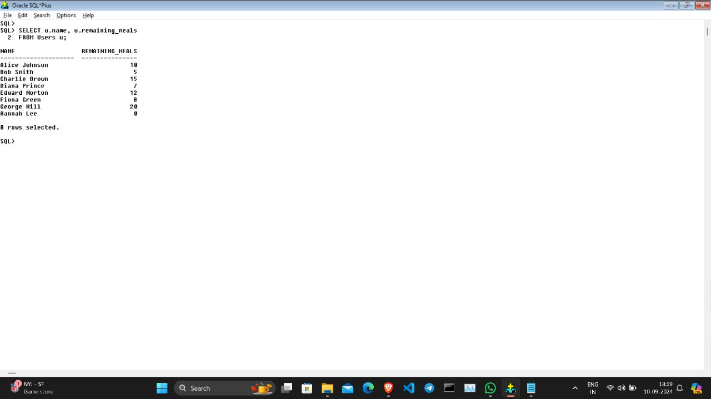
5. Check Remaining Meals for Users

Slide 17
CONTACT FOR MORE

Slide 18
CONCLUSION
To develop a Mess Management System that automates and streamlines the management of Orders, Inventory, Payments, Users, and Meal Plans. This system will ensure timely meal delivery, accurate inventory control, and real-time updates on stock and payment statuses, while enhancing user experience and operational efficiency through easy access to meal plans and personalized services.

Slide 19
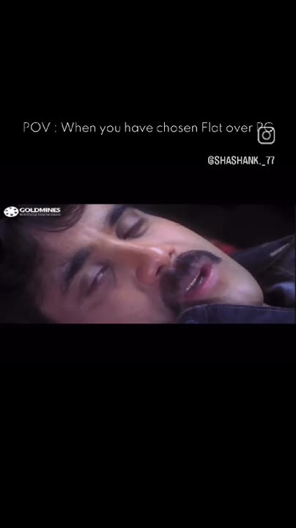
HOME FOOD >>>>> MESS FOOD

